Slide 1
GR Review
Read the instructions!!! Is it setup or solve?
What should you know?
Everything!
Riemann Sums:
LHS, RHS, etc
Which ones under/over estimate
Integration methods: tables & substitution
Antiderivatives (4.9):
Given f’(x), how to draw f(x) / f’’(x)
Understand what the curves mean (area, distance, velocity, etc)
Calc area integrals: under curve, between curve
Calc volume: disk, washer, shell
Use the right tool from your toolbox!

Slide 2
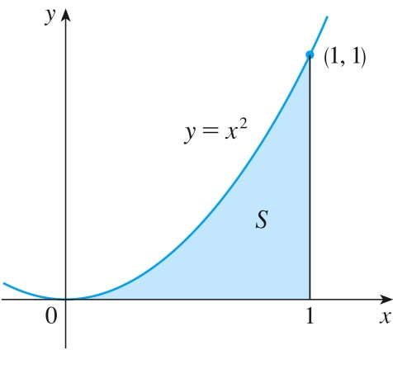
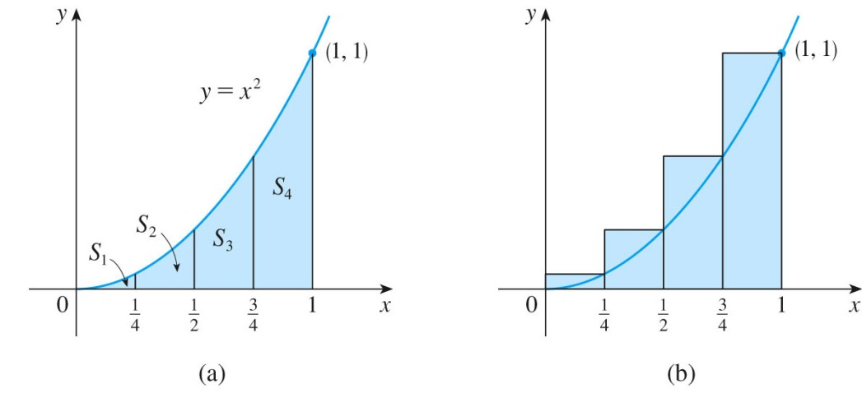
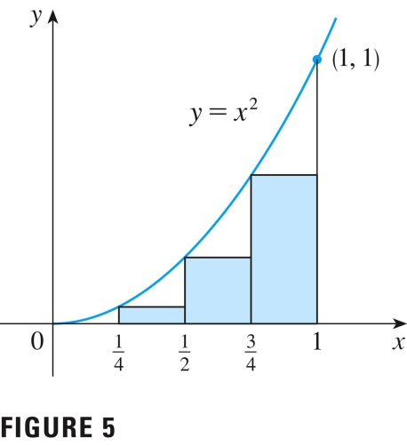


Area Under a Curve
Use rectangles to estimate the area under the parabola y = x² from 0 to 1.
We see that the area of S is larger than LHS₄, so we have lower and upper estimates for S: 0.21875 < S < 0.46875
RHS
LHS
${RHS}_{4}= \frac{1}{4}{\left(\frac{1}{4}\right)}^{2}$+$\frac{1}{4}{\left(\frac{1}{2}\right)}^{2}\text{+} \frac{1}{4}{\left(\frac{3}{4}\right)}^{2}$+$\frac{1}{4}{\left(1\right)}^{2}=\frac{15}{32}=0.46875$
${LHS}_{4}=\frac{1}{4}{\left(0\right)}^{2}+\frac{1}{4}{\left(\frac{1}{4}\right)}^{2}$+$\frac{1}{4}{\left(\frac{1}{2}\right)}^{2}\text{+} \frac{1}{4}{\left(\frac{3}{4}\right)}^{2}=\frac{7}{32}=0.21875$
Notes:
Solid example with a function

Slide 3


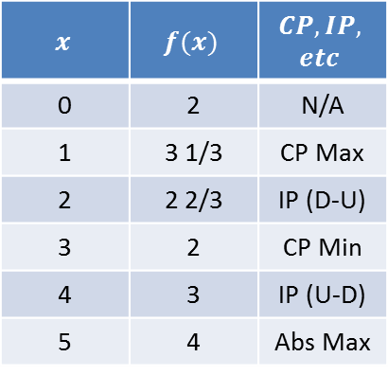


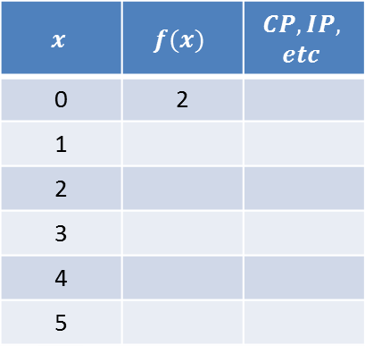


Graphing Antiderivatives
$$x$$ | $$f(x)$$ | $$CP,IP,$$ $$etc$$
0 | 2 | N/A
1 | 3 1/3 | CP Max
2 | 2 2/3 | IP (D-U)
3 | 2 | CP Min
4 | 3 | IP (U-D)
5 | 4 | Abs Max
$$x$$ | $$f(x)$$ | $$CP,IP,$$ $$etc$$
0 | 2
1
2
3
4
5
$$f′(x)$$
Area = 2
Area = 4/3
Area = 4/3
$$f(x)$$
$$( − )$$
$$( + )$$
$$( − )$$
$$f"(x)$$
Notes:
0
2
NA
1
$3\frac{1}{3}$
Max
2
$2\frac{2}{3}$
IP (DU)
3
2
Min
4
3
IP(UD)
5
4
Max

Slide 4
Communicate Properly
Other instructors will grade your GR’s not me alone

Slide 5
Math 152 – Lesson 10
Lesson | Topic | Reading
9 | Volumes | 6.2
10 | Volumes & Cylindrical Shells | 6.3
11 | GR #1
Objectives:
Calculate volumes using cylindrical shells
Recognize whether the shell/disk/washer method is appropriate
Notes:
http://www.youtube.com/watch?v=KdxEAt91D7k

Slide 6
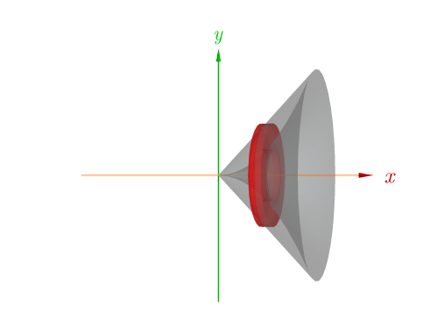
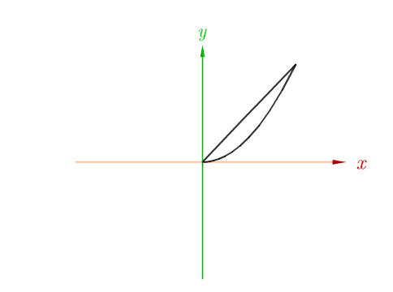
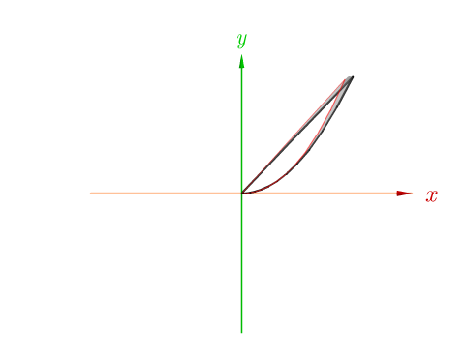
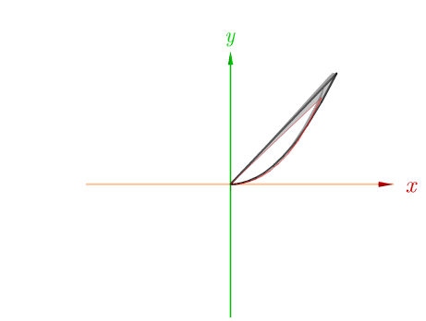
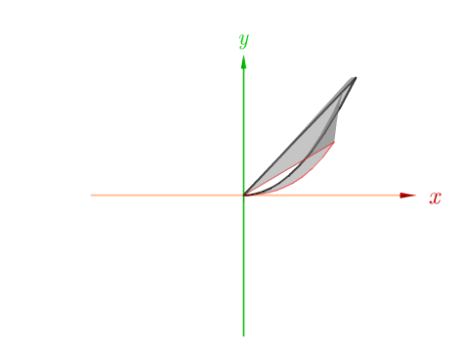
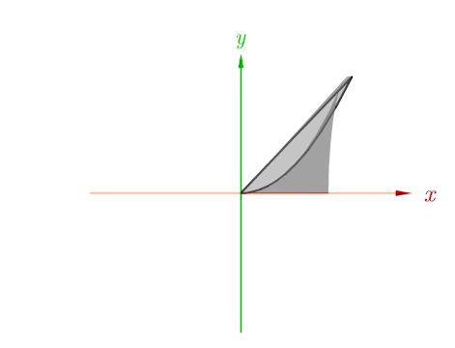
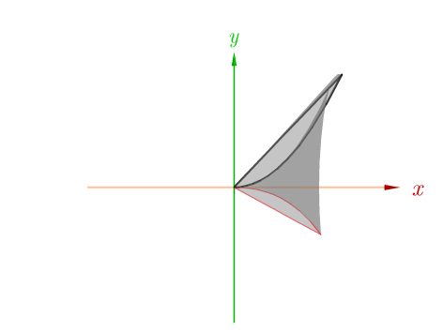
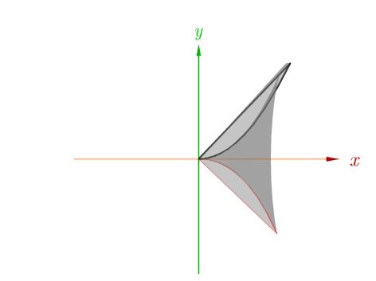
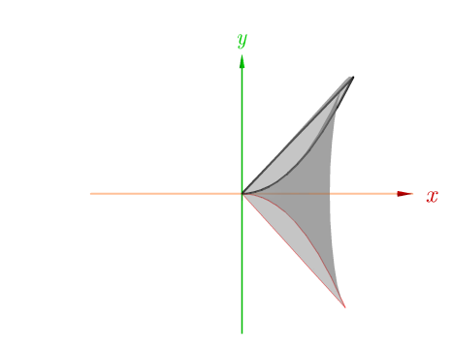
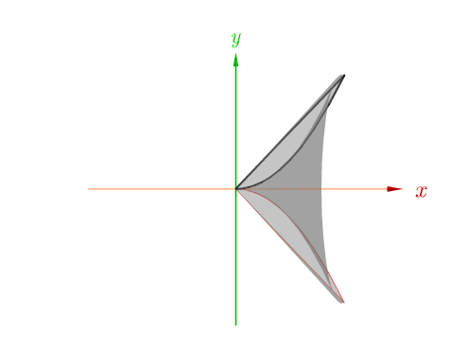
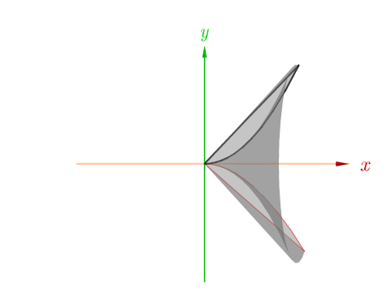
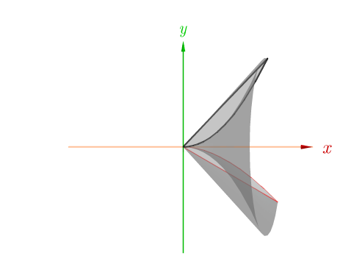
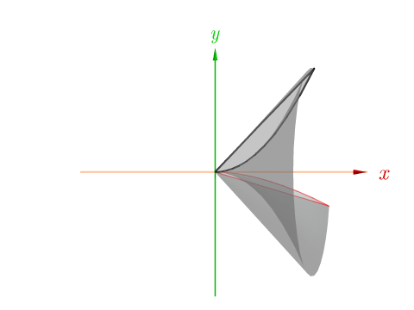
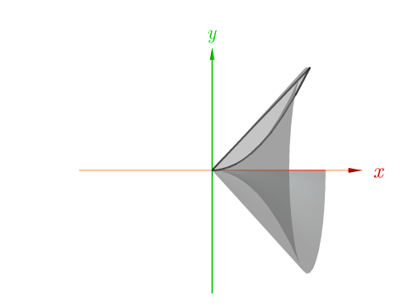
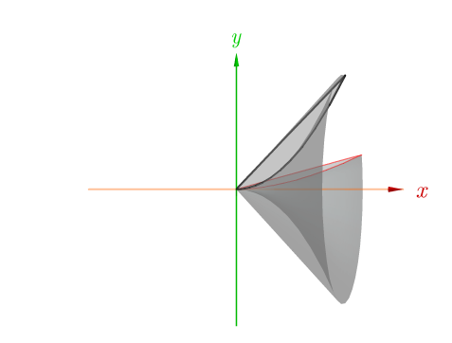
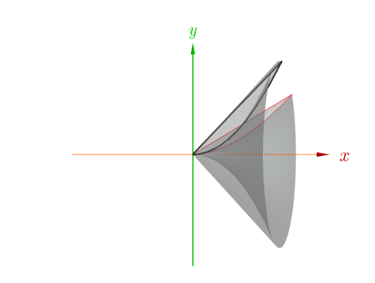
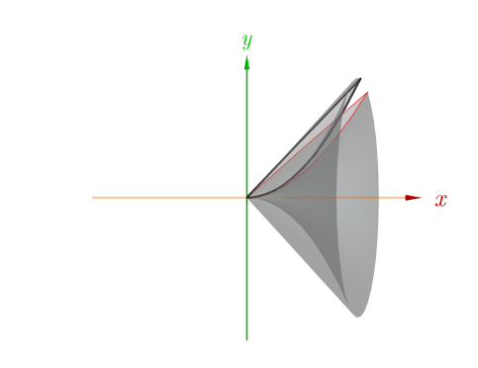
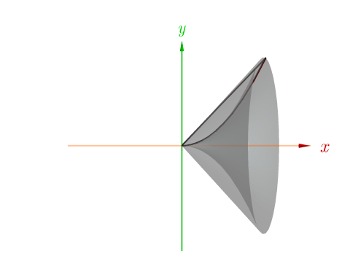
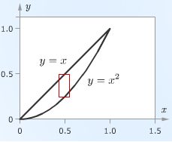





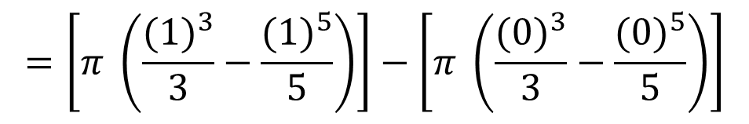
Review
$y=x$
$y=x^{2}$
$$V_{Slice}= \left(π r{}_{out}^{2 }{∆x}\right) − \left(π r{}_{in}^{2 }{∆x}\right)$$
$$=\left(π {\left(x\right)}^{2}∆x\right)−\left(π {\left(x^{2}\right)}^{2}∆x\right)$$
$$=π (x^{2}−x^{4}) ∆x$$
$$Volume=\int_{0}^{1}{π (x^{2}−x^{4})} dx$$
$$=\left[π \left(\frac{{(1)}^{3}}{3}−\frac{{(1)}^{5}}{5}\right)\right]−\left[π \left(\frac{{(0)}^{3}}{3}−\frac{{(0)}^{5}}{5}\right)\right]$$
$$=π\frac{2}{15}$$
Notes:
“h” is the “height” of the disc or washer…except here, it is on its side
it is the thickness of the disc/washer—delta-x

Slide 7
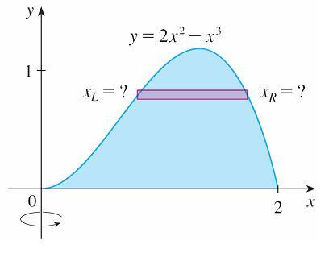
Volumes by Cylindrical Shells
Let’s consider the problem of finding the volume of the solid obtained by rotating about the y-axis the region bounded by y = 2x² – x³ and y = 0. (See Figure 1.)
Looks like cross section of washer
Figure 1
Doesn’t work !!!!

Slide 8
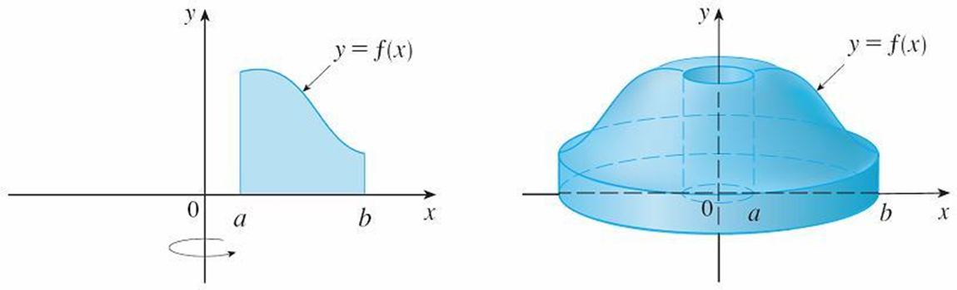
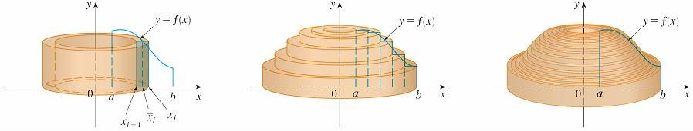
Cylindrical Shells

Slide 9
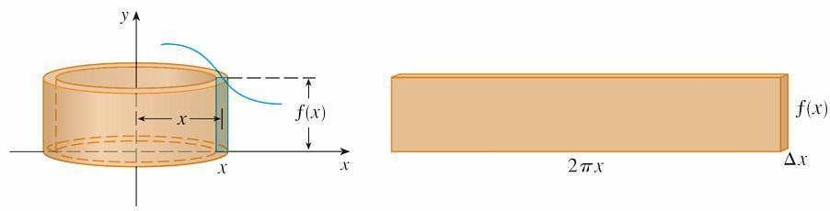
Cylindrical Shells
V_{i} =
Unwrapped cylindrical shell

Slide 10
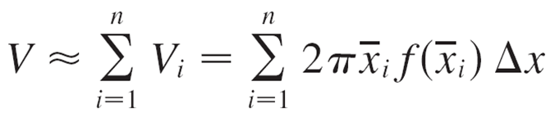
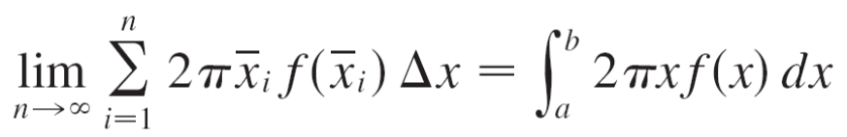
Cylindrical Shells

Slide 11
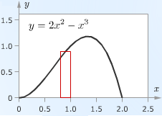
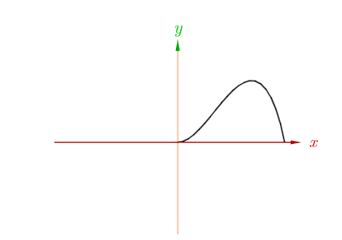
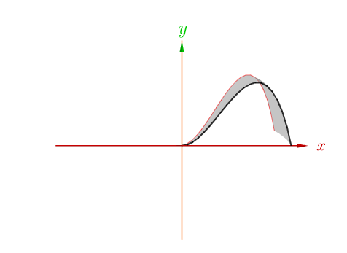
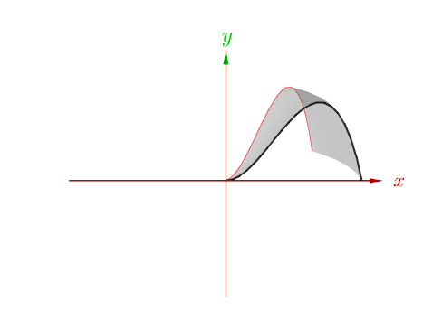
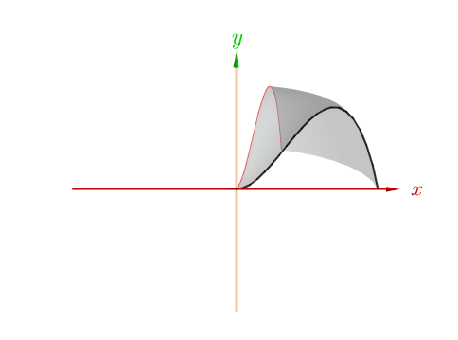
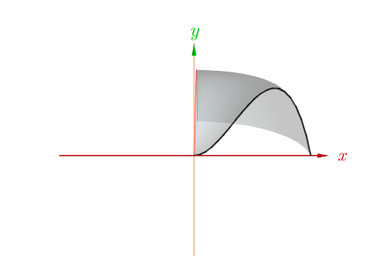
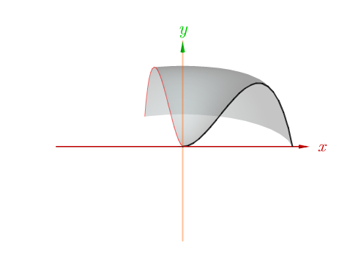
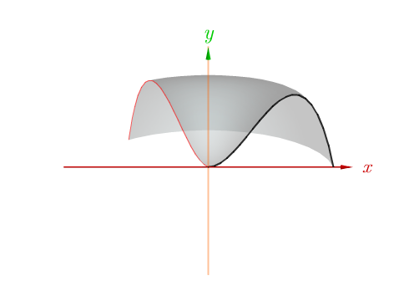
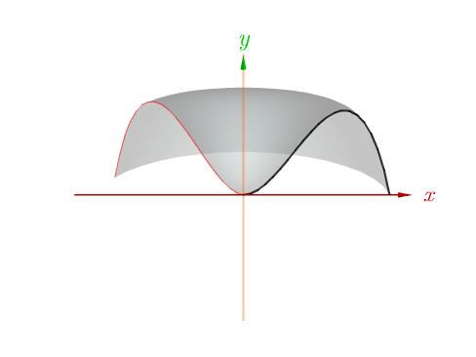
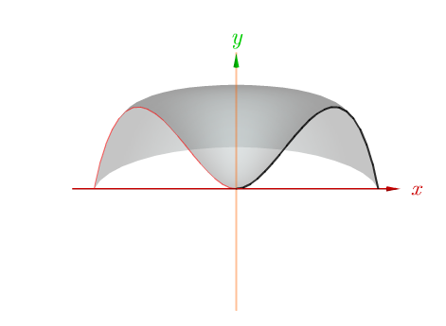
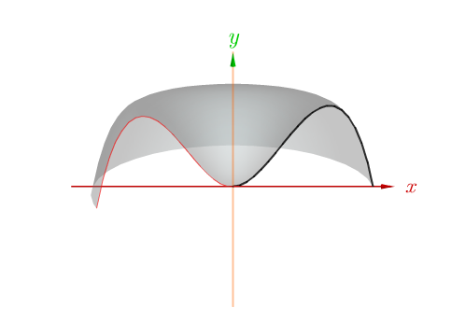
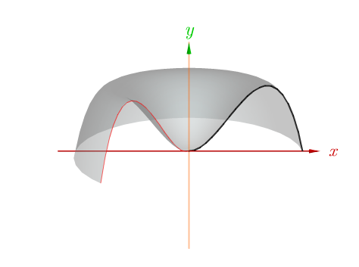
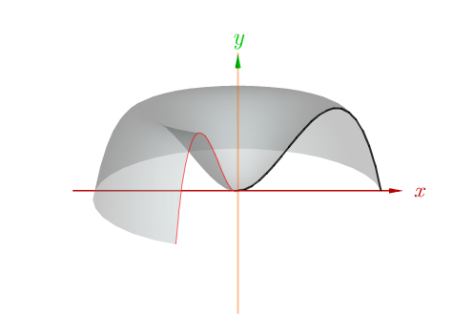
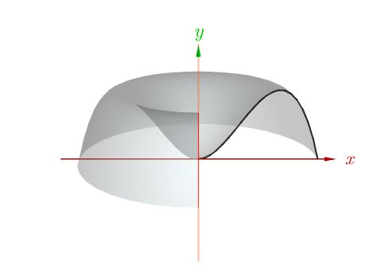
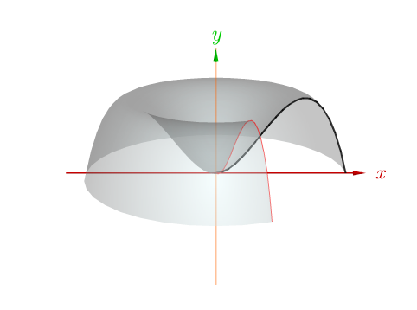
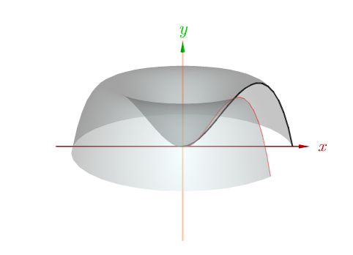
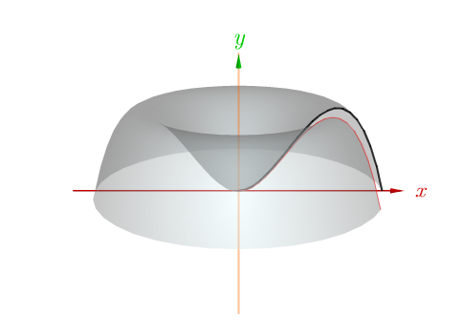







Cylindrical Shells
$$y=2x^{2}−x^{3}$$
$$V_{Shell}=(2 π r) h ∆r$$
$$=2 π x\left(2x^{2}−x^{3}\right) ∆x$$
$$=\frac{16π}{5}$$
$Volume$ $=\int_{0}^{2}{2 π x\left(2x^{2}−x^{3}\right) dx}$

Slide 12

Board Work
Find the volume of the solid obtained by rotating about the y-axis the region bounded by y = 2x² – x³ and y = 0.
y = 2x² – x³
2
Figure 6

Slide 13


Board Work
Solution:

Slide 14



Board Work
Use cylindrical shells to evaluate the volume of the shaded region rotated about the $y−axis$.
$Solution: π$/15 & 2$π$
Notes:
6.3, #1 & 2, p444
$π$/15 & 2$π$

Slide 15


Board Work
Use cylindrical shells to evaluate the volume of the shaded region rotated about the $y−axis$.
$$V= \int_{0}^{1}{2π}x\left(x^{3}−2x^{2}+x\right)dx$$
$V=π$/15
$${u=x}^{2} du=2xdx$$
$V= \int_{0}^{√π}{2π}x\left(sin⁡(x^{2})\right)dx= \int_{0}^{√π}{π}$sin(u)du
V=-$πcos\left(π\right)+πcos\left(0\right)=$2$π$
Notes:
6.3, #1 & 2, p444
$π$/15 & 2$π$

Slide 17




Cylindrical Shells
$$V_{Shell}=(2 π r) h ∆r$$
Unwrapped shell

